Slide 1
Market Analysis
Luxury Cars
Taylor Whiteman, Tia Gallinaro, Simon Ko, Xinyi Wu, Brendan Sullivan
Notes:
Anti-laws of marketing???

Slide 2
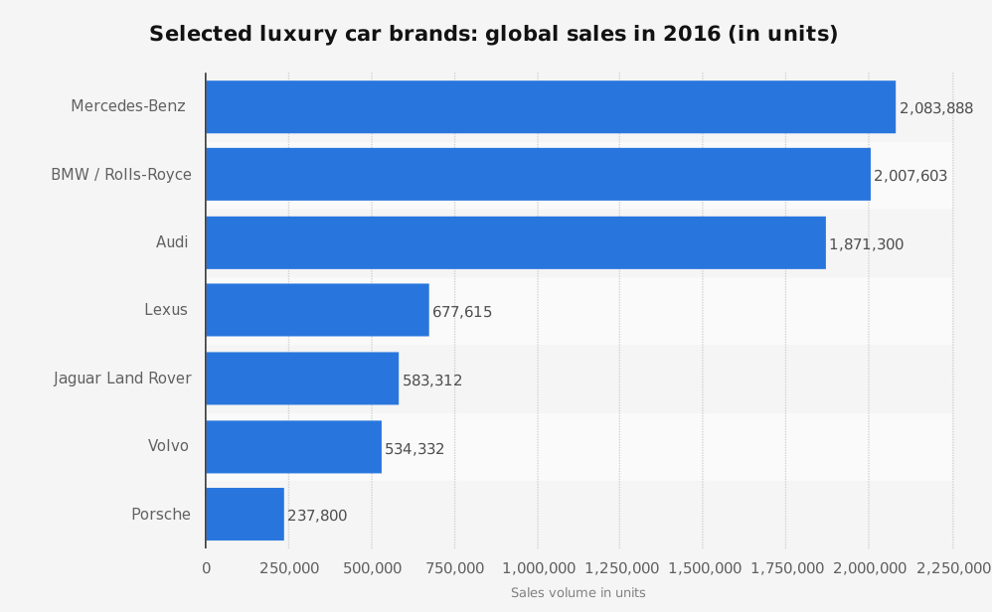
Brief Overview of Luxury Car Industry
Mercedes Benz, BMW, and Audi - 80% share in global luxury car market
China - the largest auto market since 2009
New focus market for auto manufacturers
Projected annual compounded growth rate of 12% from 2014-2020 for luxury cars
Notes:
"The auto industry has been bouncing back from the depths of 2009, and the thirst for luxury remains powerful. Good times should continue to roll for the U.S. auto market, especially in the luxury segment, into the foreseeable future, according to 2012 Special Report: Luxury Automotive Outlook, which relies on forward-looking consumer data provided by BIGinsight." -Forbes Insights: 2012 Luxury Automotive Outlook
Even though there was a decline, still strong demand for luxury

Slide 3
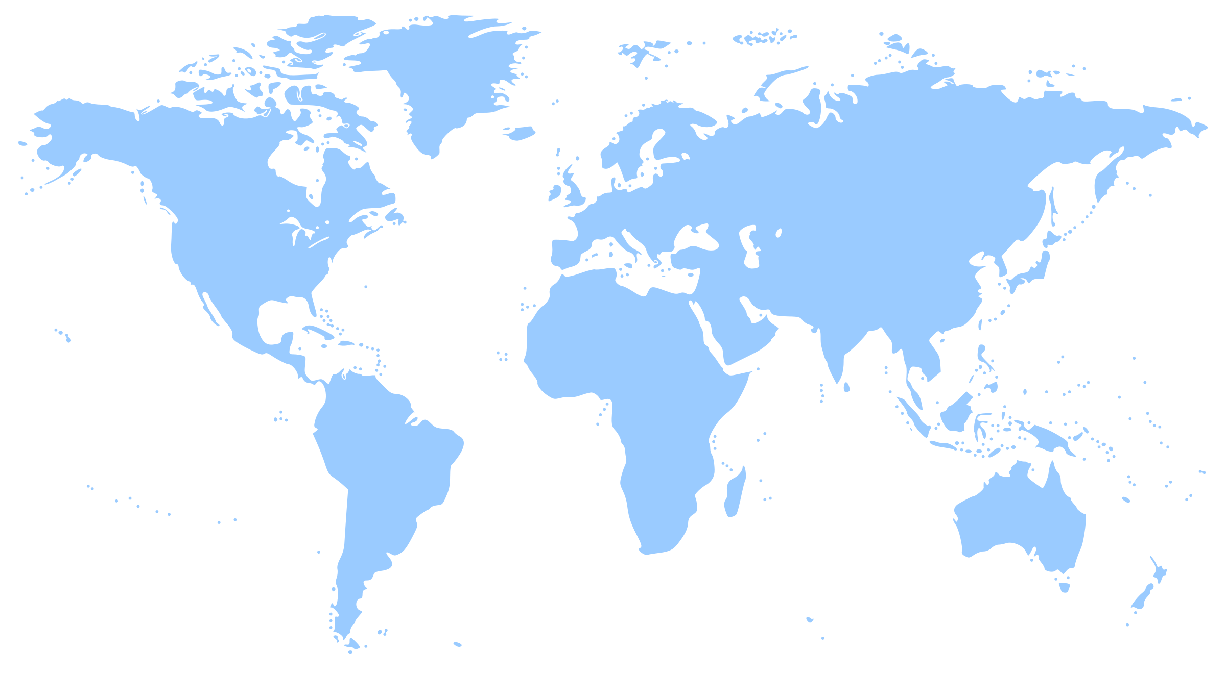




Slide 4
US Car Manufacturers

Slide 5

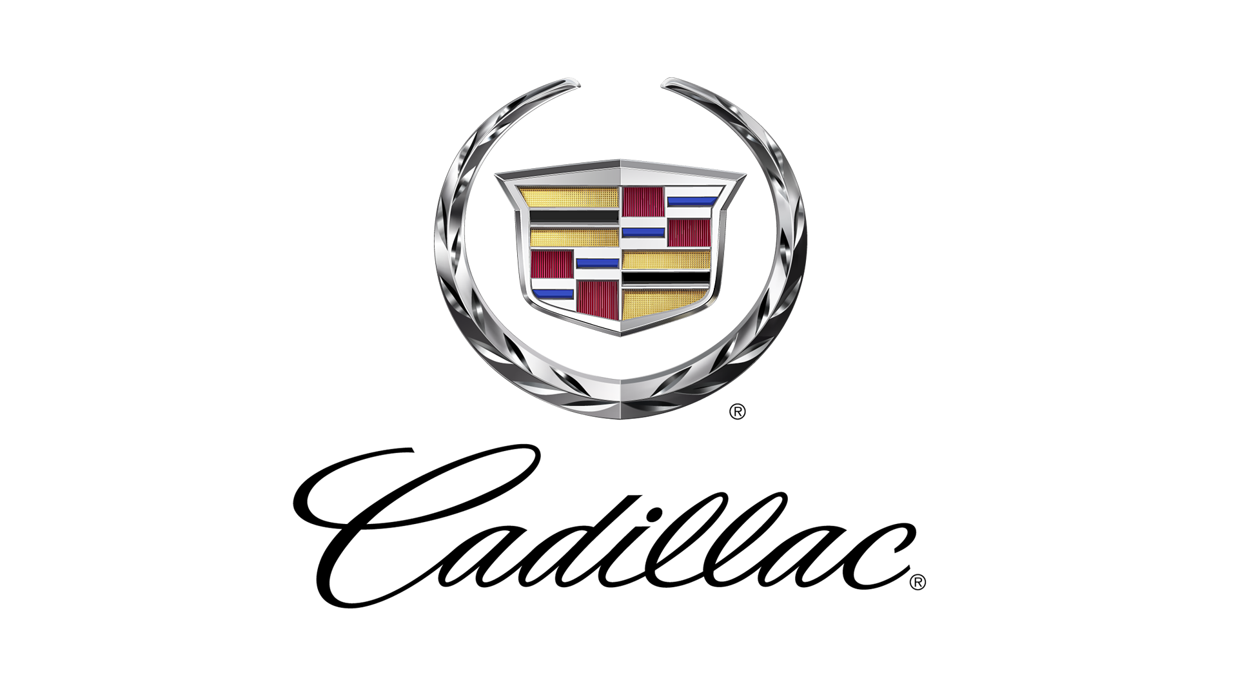

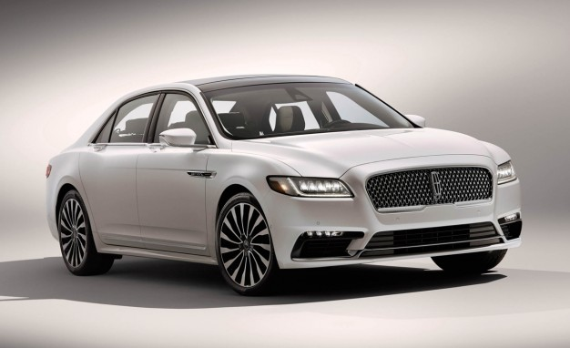
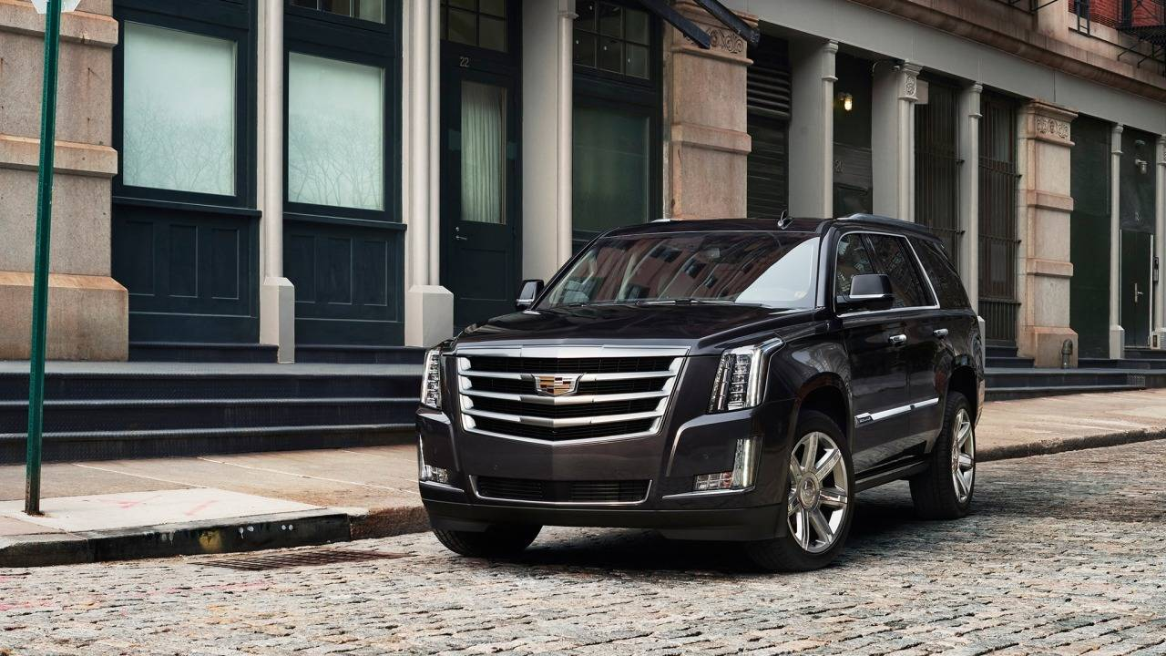
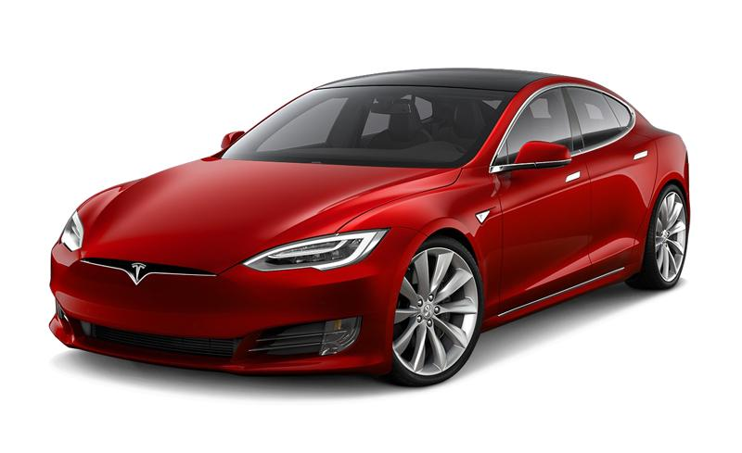
US Car Manufacturers
Most known for “Towncar”
Full brand relaunch in 2012, and an entrance into the Chinese market in 2014, reignite spark in US Luxury
Sold in Europe under the Ford marquee
Formed as the remnants of “The Henry Ford Company”
Owned by General Motors as their Luxury car marquee.
Well known for their SUV’s and Sports Cars
Founded by Elon Musk in 2003 as an all-electric car manufacturer
Known for their iconic look and driverless innovations
10% Owned by Daimler and ~7.5% Owned by Toyota
Lincoln Continental
Cadillac Escalade
Tesla Model S
Notes:
Lincoln Continental
Product line discontinued in 2012 and was brought back for 2017
The quintessential US Luxury sedan
Cadillac Escalade
Starting Price of 71,000USD
Unofficially replaced Lincoln Continental as the US “Luxury Taxi”
Tesla Model S
First in-house designed, all electric Tesla
Instead of engine sizing, has battery pack sizing
0-60mph in 2.28 seconds

Slide 6
European Car Manufacturers

Slide 7
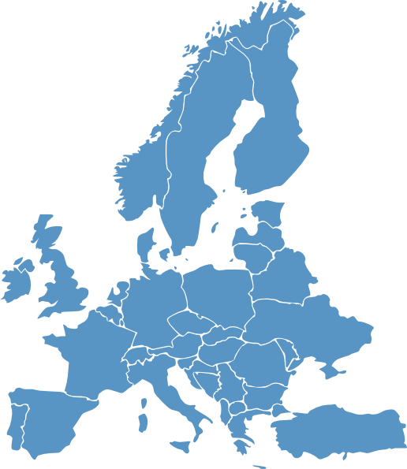






Slide 8



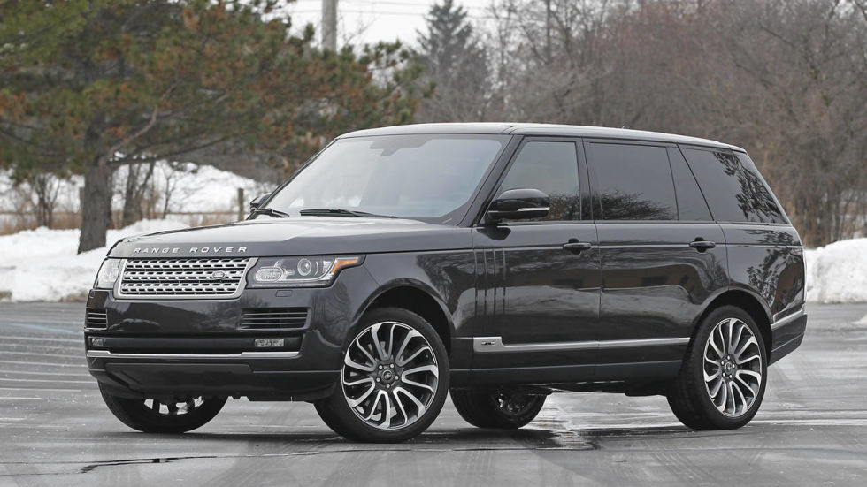
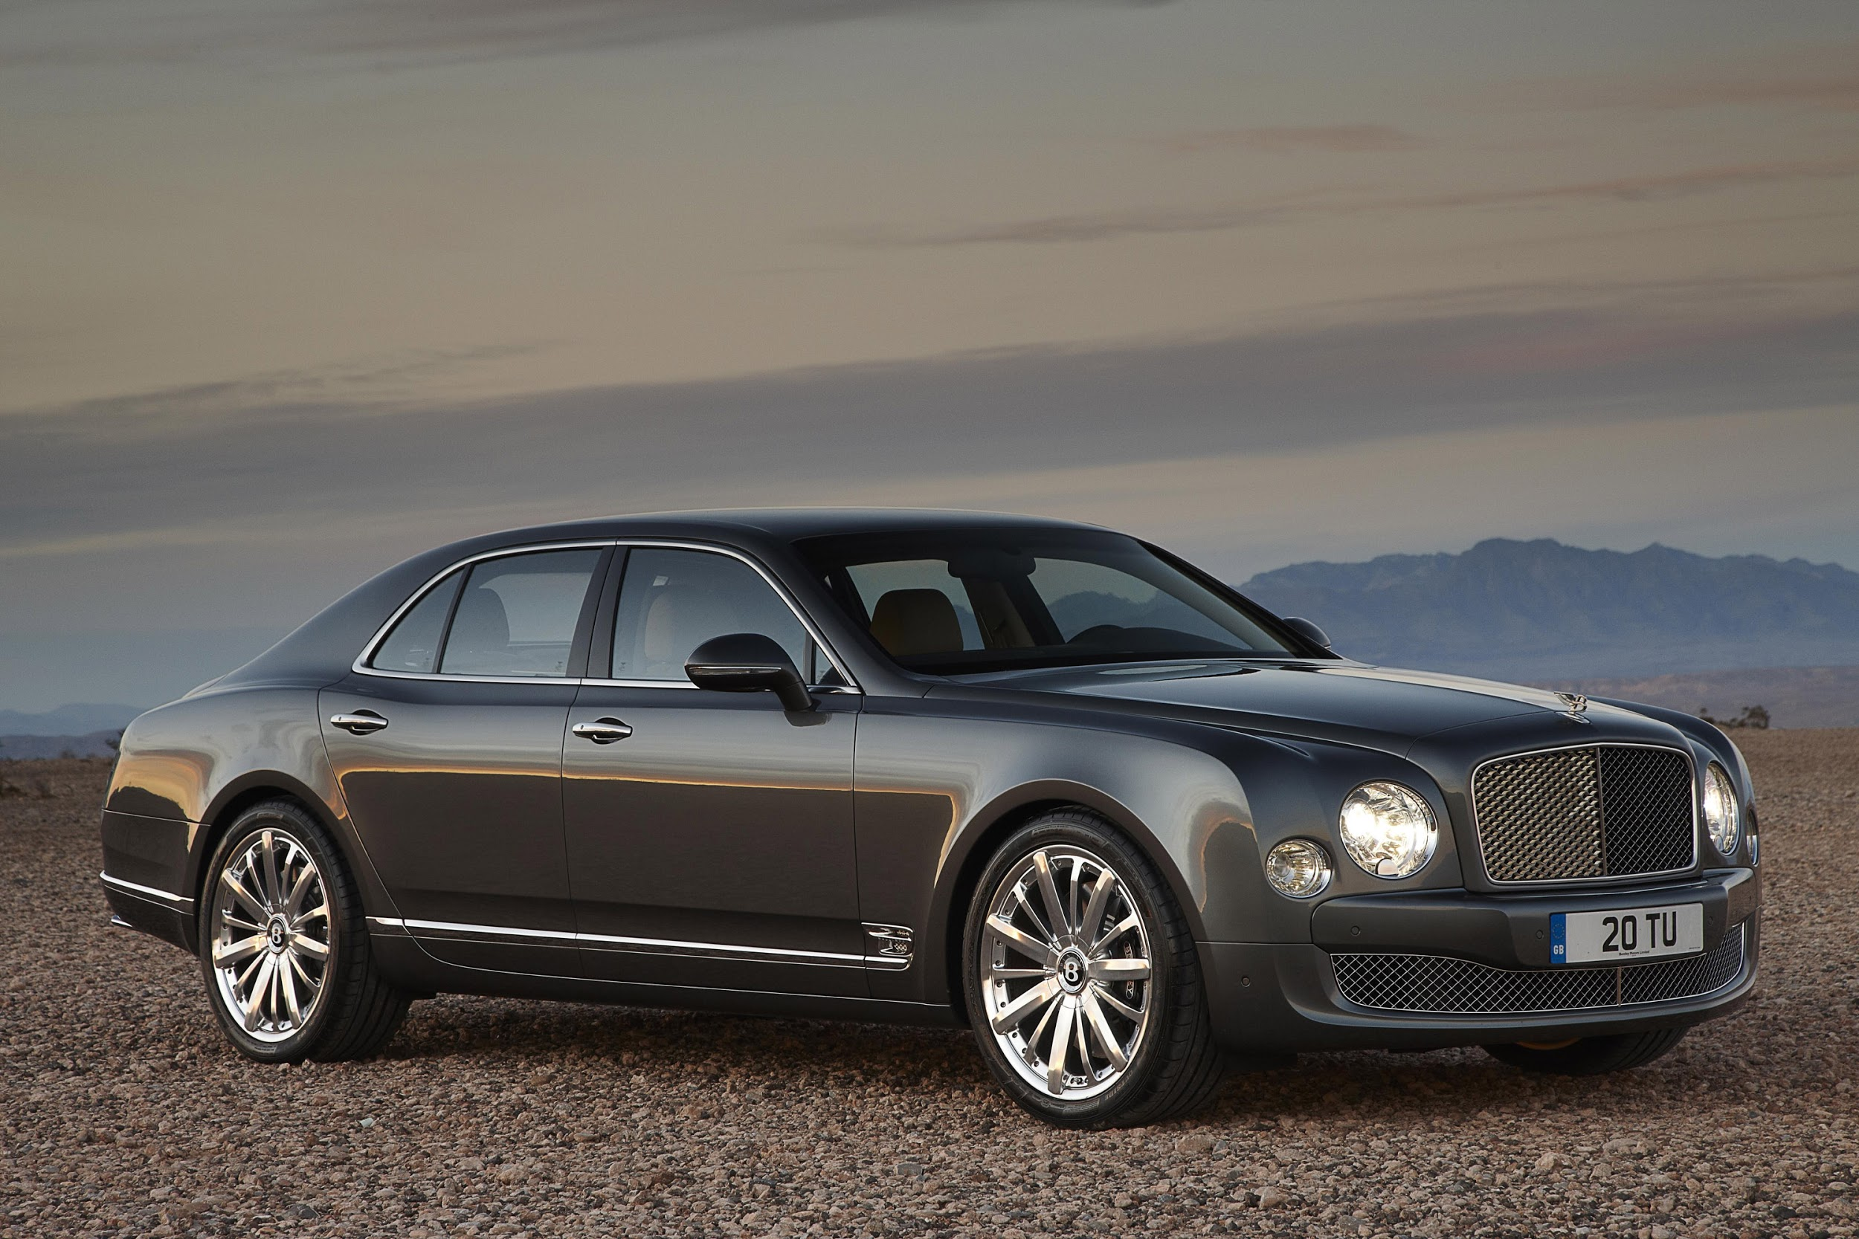
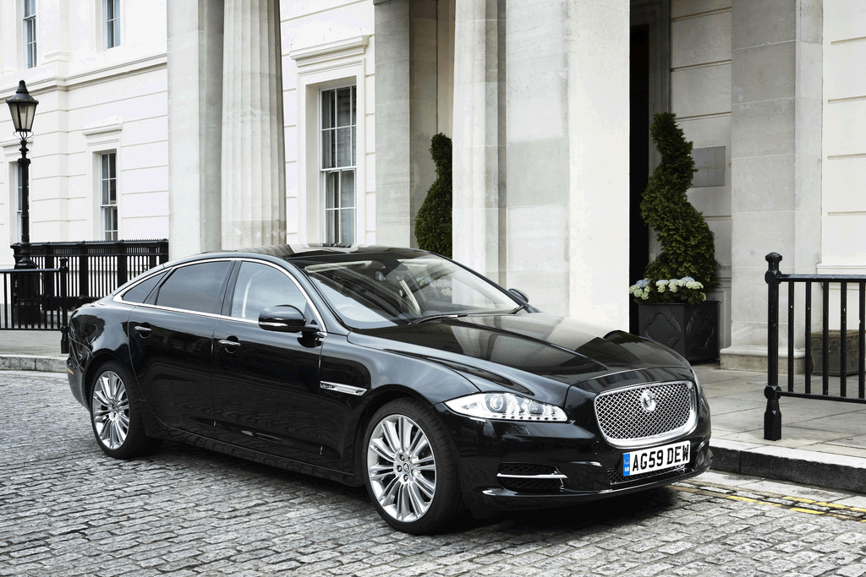
UK Car Manufacturers
Independently Owned Until 1989
Ford Motor Company → Tata Motors (2008)
Racing excellence
Jaguar was known as unreliable in the 80’s with the X-Type, but has shed that image with their newer models
Independently Owned Until 1989
Ford Motor Company → Tata Motors (2008)
Known for designing cars that can brave the toughest of conditions in the most elegant interior.
Independently Owned Until 2003
Volkswagen A.G.
Known for their wildly powerful V12 Coupes, Bentley handcrafts the finest saloons and more recently, SUVs.
Jaguar XJ
Range Rover Autobiography
Bentley Mulsanne Mulliner
Notes:
Jaguar XJ
Official Car of The Crown of England
First Car to offer a “digital dash”
R-Type Jaguars offer high-performance
Range Rover Autobiography
Starting Price of 120,000USD
Able to climb mountains or the mall parking deck
Bentley Mulsanne Mulliner
Starting Price of 306,000USD
Everything is customizable
114 Paint Colors
21 Carpet Colors
24 Leather Colors

Slide 9



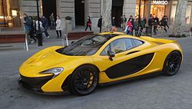
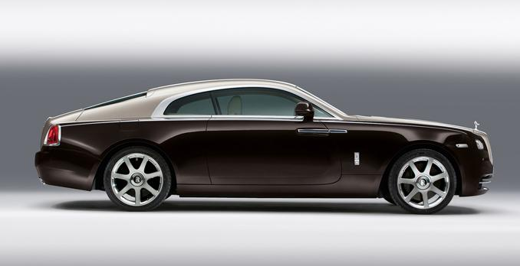
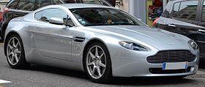
UK Car Manufacturers
Sold to BMW in 1998
Epitome of luxury
Understands what their buyers want and gives them things they wouldn’t think they would ever need
Spirit of Ecstasy
Purchased by Ford in 1996, but regained independence in 2006
Elegant, Fast, and Dangerous
Iconic wings badge synonymous with A.M since 1927
Bruce Mclaren, famous F1 racer, turned high-end car producer.
Mclaren creates unique high-performance vehicles.
It is not unheard of for them to make a 1-seat vehicle
Rolls Royce Wraith
Aston Martin Vantage
McLaren P1
Notes:
Rolls Royce Wraith
Starting Price of 315,700USD
First-Ever GPS Guided Transmission
Built off of the same platform as a BMW 7-Series
Aston Martin Vantage
Starting price of 121,000USD
Over 1,000,000 customized combinations
Mclaren P1
Starting price of 1,150,000USD
The pinnacle of Mclaren’s racing knowledge

Slide 10
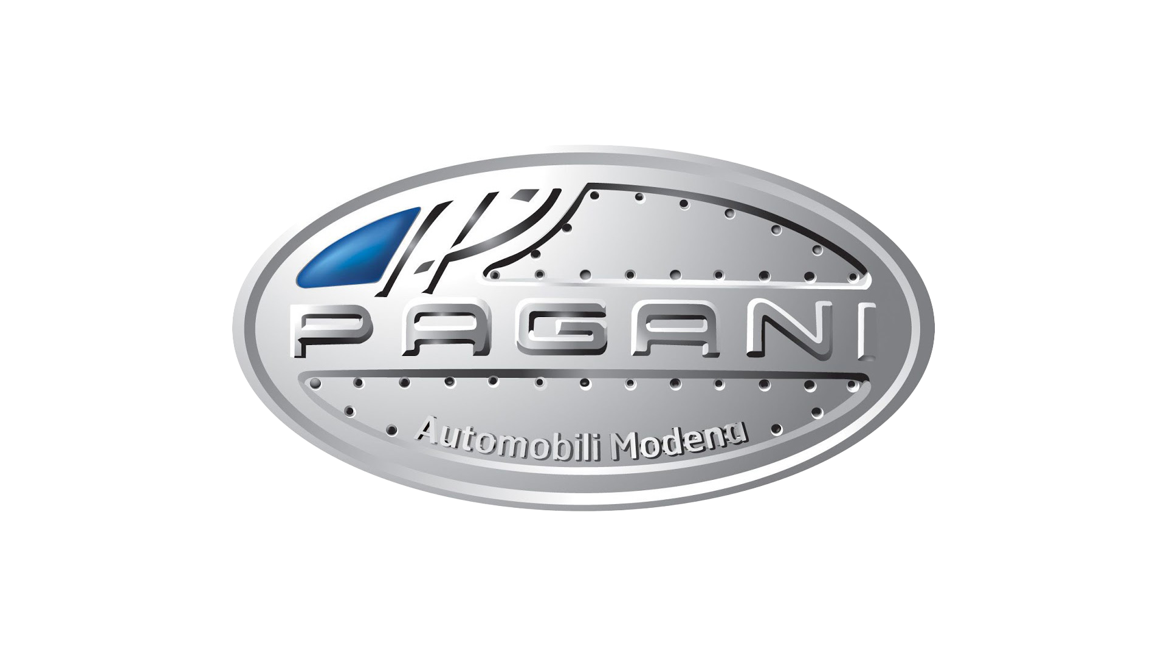
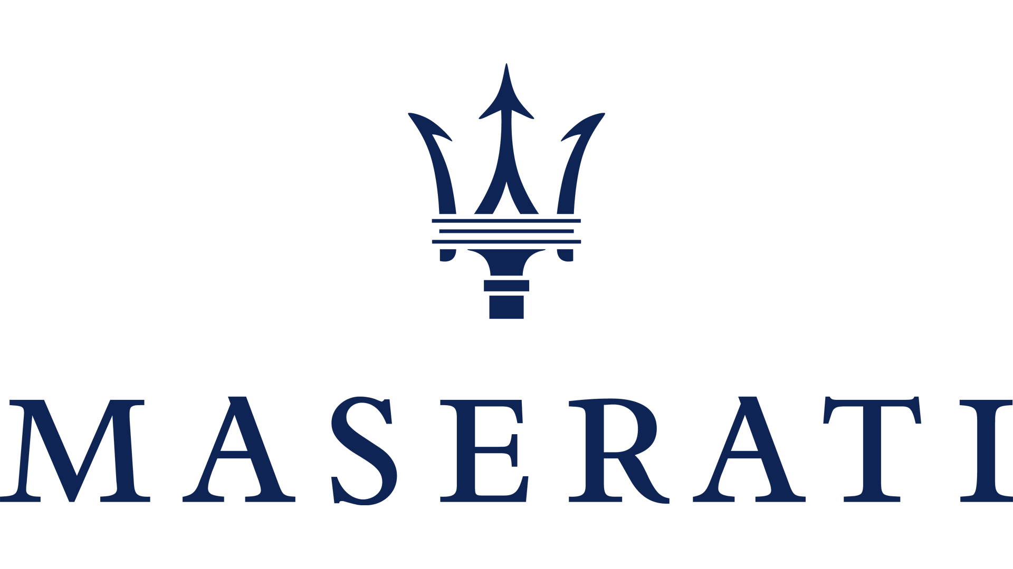
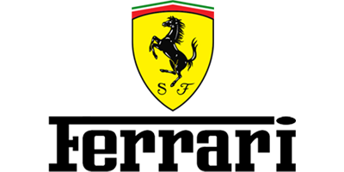
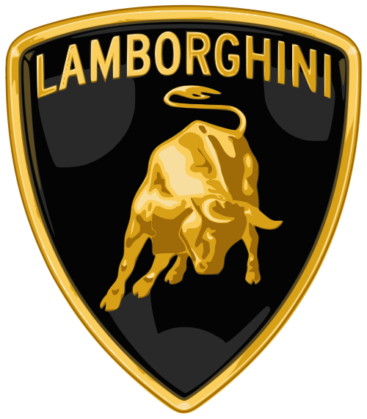
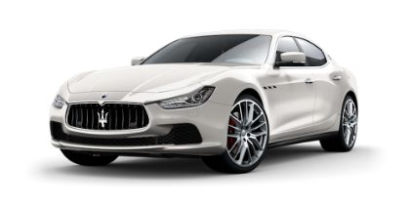
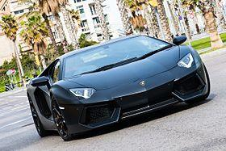
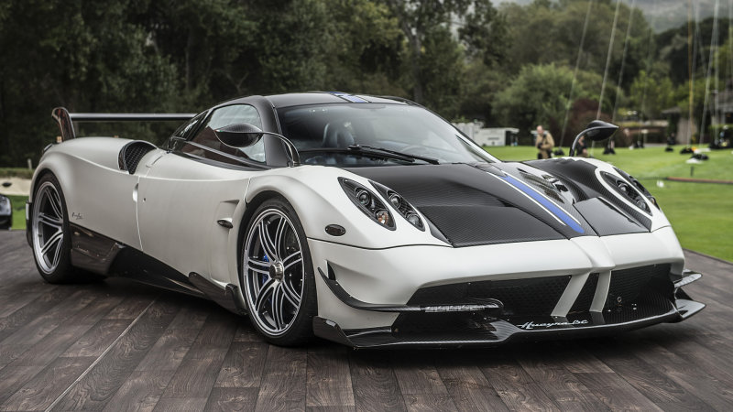
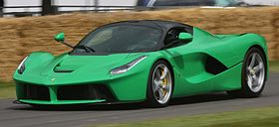
Italian Car Manufacturers
Originally known for their strong racing heritage and design capabilities,
Recently appealing to the mass market with the Ghibli and Levante models
Purchased by Fiat-Chrysler in 2014
Known for their racing heritage and ability to push the boundaries of speed & aerodynamics
Ferrari’s most direct competitor
Owned by Audi, who is owned by Volkswagen
Like Ferrari, they push the boundaries of what is possible with automotive technology
Small Italian auto-manufacturer known for high-performance vehicles that unofficially have faster lap times than Lamborghini, Ferrari, Bugatti, and Aston Martin
Maserati Ghibli
Ferrari LaFerrari
Lamborghini Aventador
Pagani Huyara
Notes:
Maserati Ghibli
Starting price of 56,000USD
Breaks every ALM in the book!
Ferrari LaFerrari
Most Recent Auction Price of 7,000,00USD
Built entirely from Carbon Fiber
Lamborghini Aventador
Starting Price of $400,000
Over 5,000 Models Built
A first for Lamborghini
Pagani Huyara
Starting Price of 850,000EUR
Uses a Mercedes-Benz built motor

Slide 11


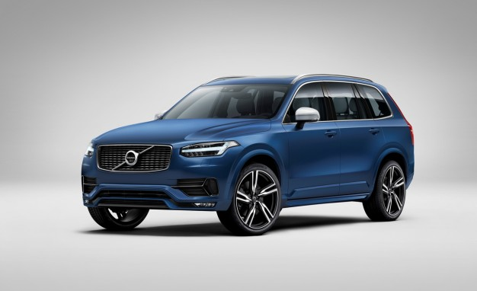
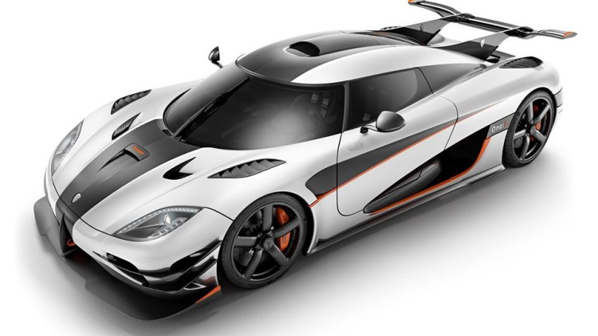
Swedish Car Manufacturers
Independently Owned Until 2001
Bought by Ford Motor Company
Sold to Tata Motors in 2013
Historically seen as a safe car. With Tata they have been reinventing themselves as a luxury brand
Niche Hyper-Car Manufacturer
Known for making the second fastest car in the world
Produces less than 50 cars per year, with only 3 dealerships in the US
Lacks common features like Navigation System & Heated Seats
Volvo XC90
Koenigsegg Agera One:1
Notes:
Volvo XC90
Debuted at NYIAS 2015
Best in class autonomous driving
Orrefors crystal drive selector
Agera
Combination of the Sweedish word “To Take Action” & the Greek “Ageless”
Fastest 0-200mph time in the world (20.71)

Slide 12
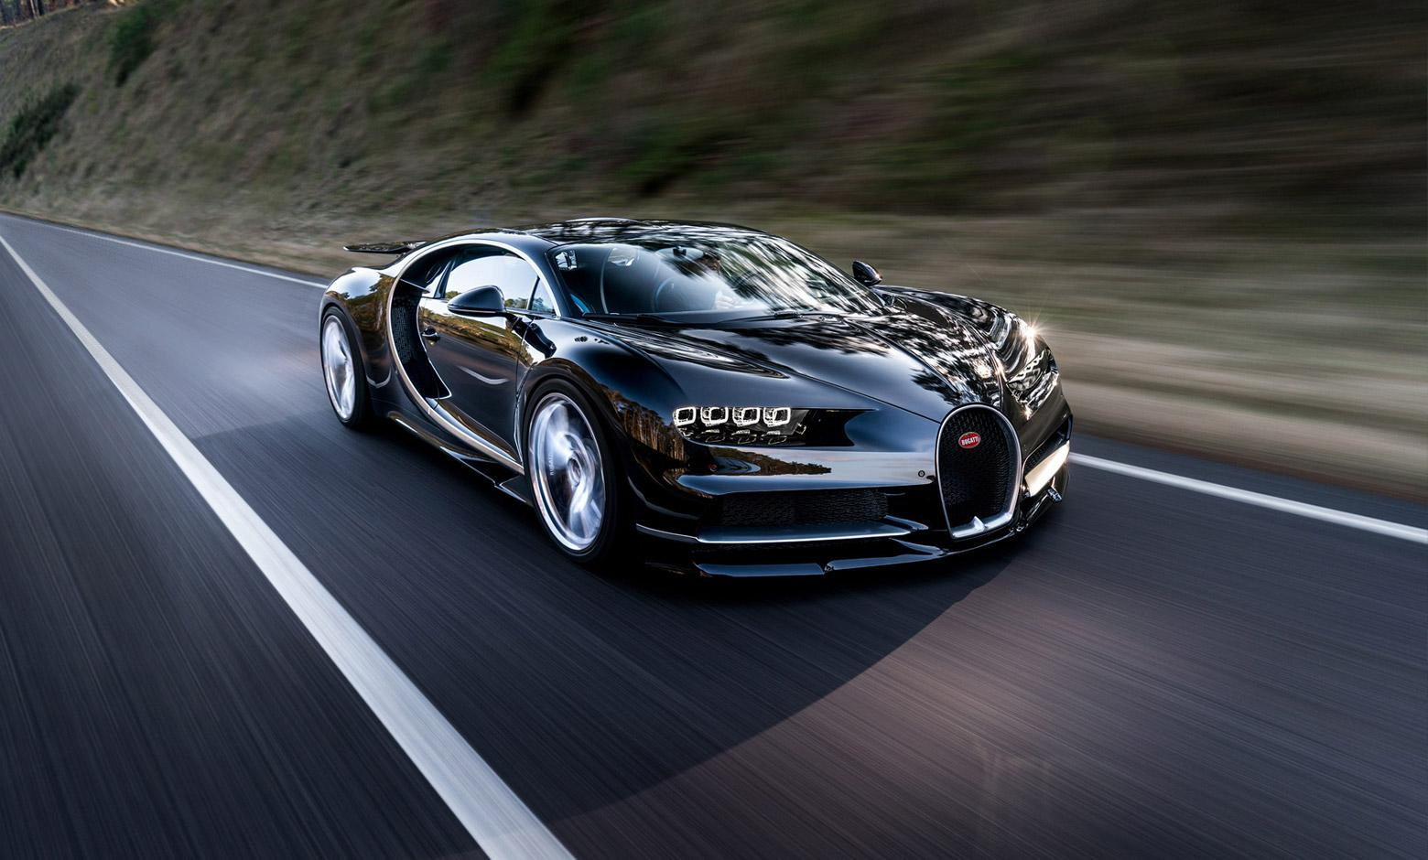
Bugatti
Chiron
2.4 Million Euros
Top Speed of 288mph
Set to become the fastest car in the world, beating its predecessor’s record by 22mph
Founded in 1909, Went Bankrupt in the 1960s and was revived in 1990
Known for making the fastest automobile in the world - The Veyron
Car design is a delicate balance between speed and comfort

Slide 13
Germany: The Big Three
& Porsche

Slide 14
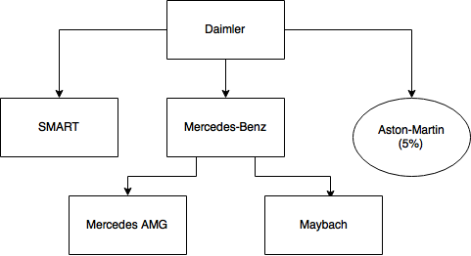
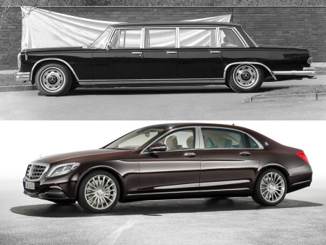
Daimler
MB is credited as creating the first automobile in 1886
Cars range from $30,000USD to $250,000USD

Slide 15
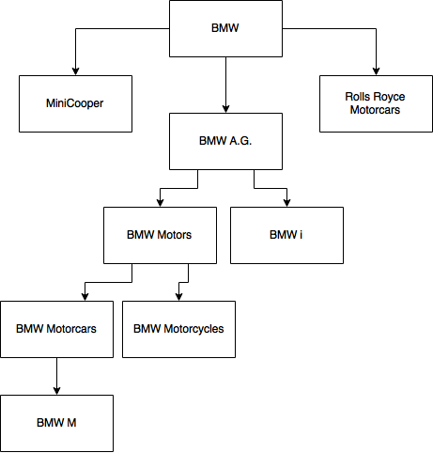
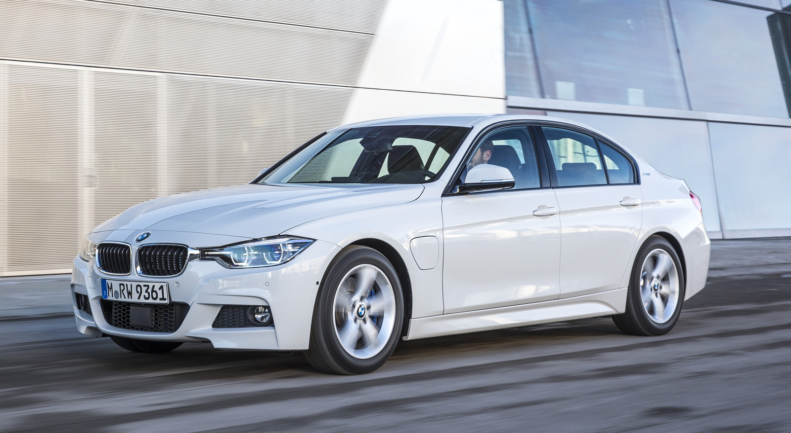
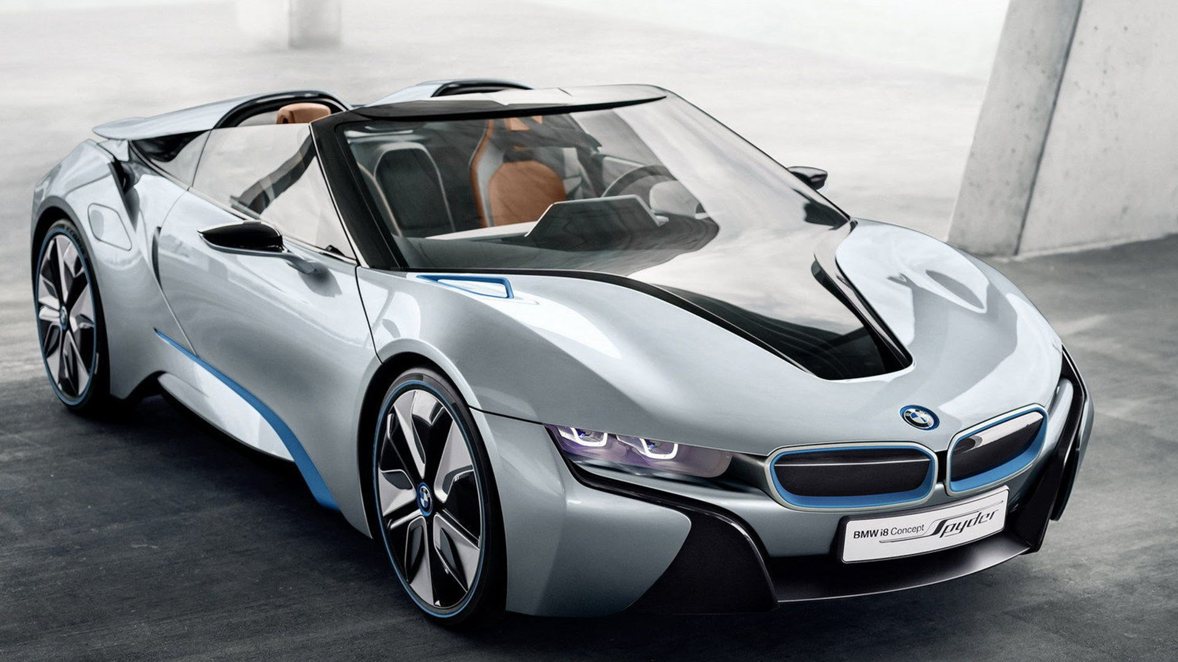
Bavarian Motor Works
Known for innovation and pushing forward
Outsells MB in compact luxury car segment (3-Series)

Slide 16
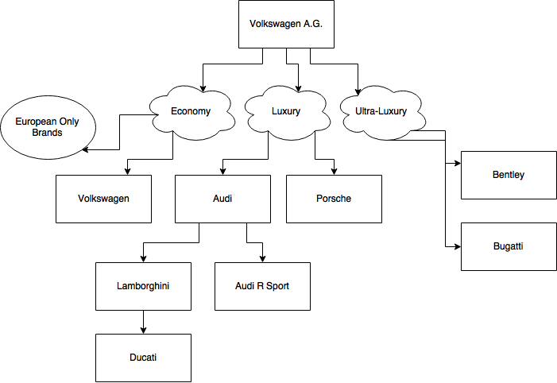
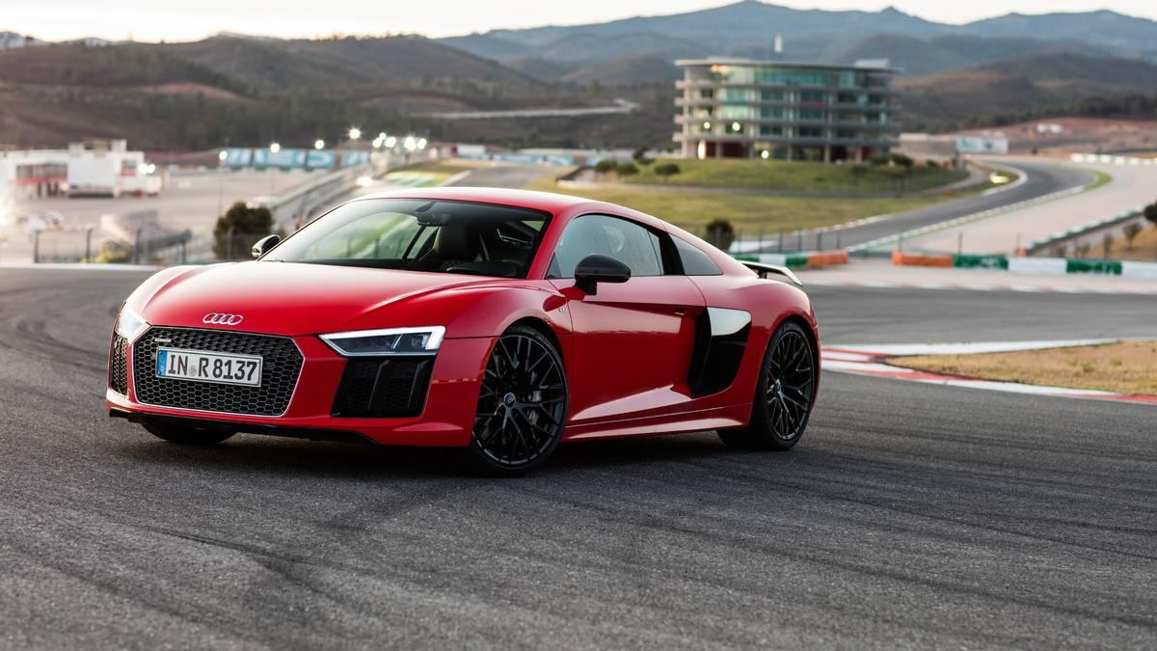
Volkswagen
Known for racing excellence both on track and offroad
Fastest growing German Car Manufacturer

Slide 17
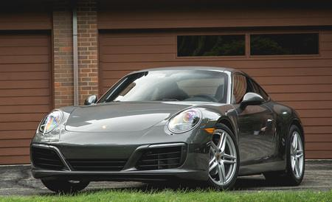
Porsche
Porsche 911 Carrera S
Quintessential German Engineering
Prices range from 80,000USD to 150,000USD
Ferdinand Porsche, the same creator of the Volkswagen Bug & Bus, used his knowledge of automotives to create the “ideal sportscar”
With a wide fan-base, Porsche is known as a high-end sports car that blends state-of-the-art technology with affordability

Slide 18
Asian Car Manufacturers

Slide 19
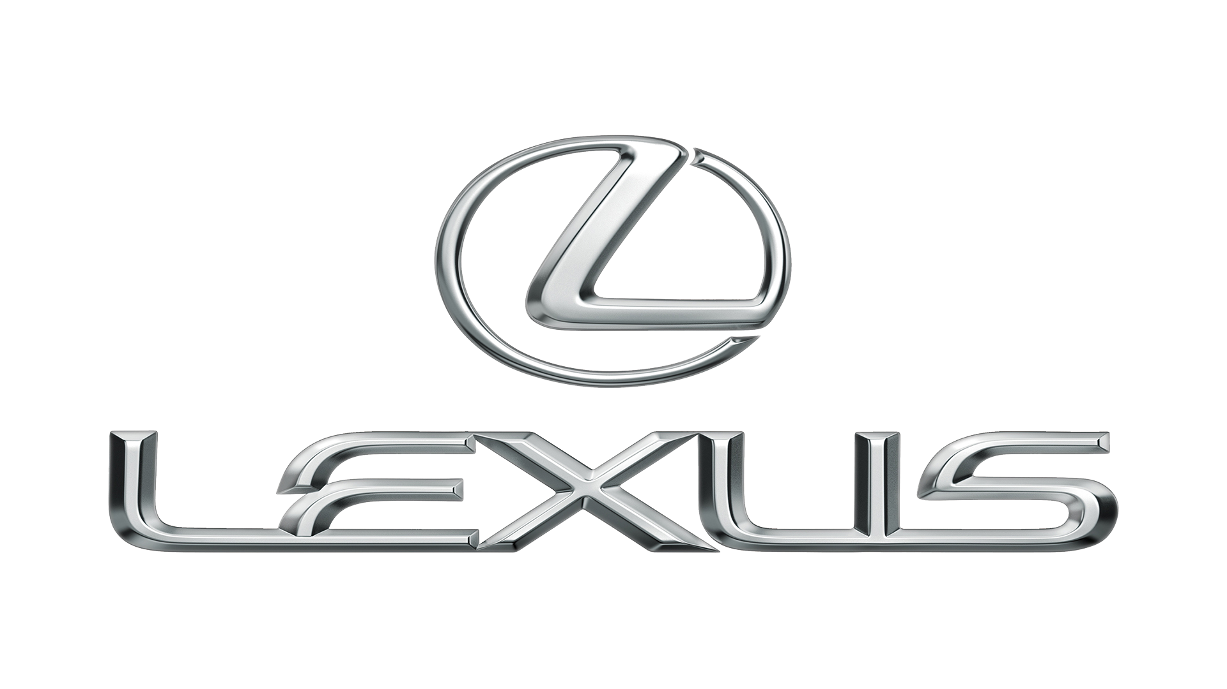

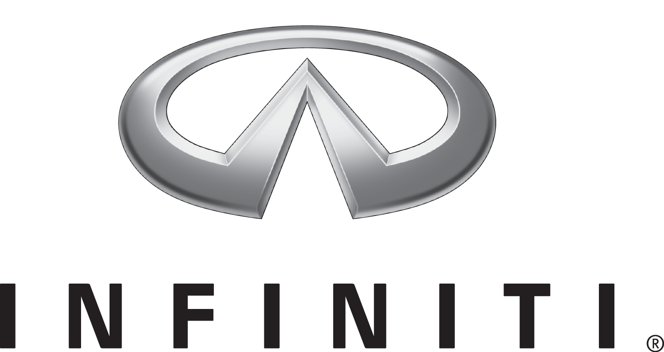
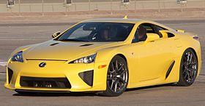
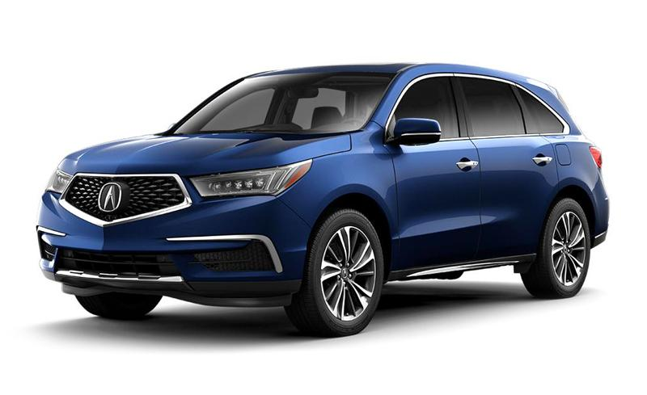
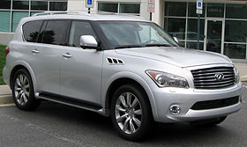
Japanese Car Manufacturers
Subsidiary of Toyota
Second largest auto company in the world
Created their first “sports car” with a starting Price of 375,000USD
Most well known for their high-end sedans
Subsidiary of Honda
Large-Size SUV capable of carrying 8 passengers
Built Exclusively in Lincoln, Alabama
The Acura brand is not available for sale in Japan
High-End SUV that seats 8 with best in-class legroom
Design based off the Nissan Aramada
In Japan Infiniti Cars are sold under the Nissan Brand
Lexus LFA
Acura MDX
Infiniti QX56
Notes:
Lexus, a subsidiary of Toyota, is known for their high end sedans and SUVs
The Lexus LS is known as being an high-end luxury sedan, directly competing with MD S-Class, BMW 7-Series, and Audi A8
Parent Company, Toyota, is second largest auto manufacturer, behind Volkswagen
Lexus LFA
Starting Price of 375,000USD
Car buyers didn’t associate the high price with its relative performance
Acura MDX
Large-Size SUV capable of carrying 8 passengers
Built Exclusively in Lincoln, Alabama
Infiniti QX56
High-End SUV that seats 8 with best in-class legroom
Design based off the Nissan Aramada

Slide 20
Vintage Car Resale

Slide 21
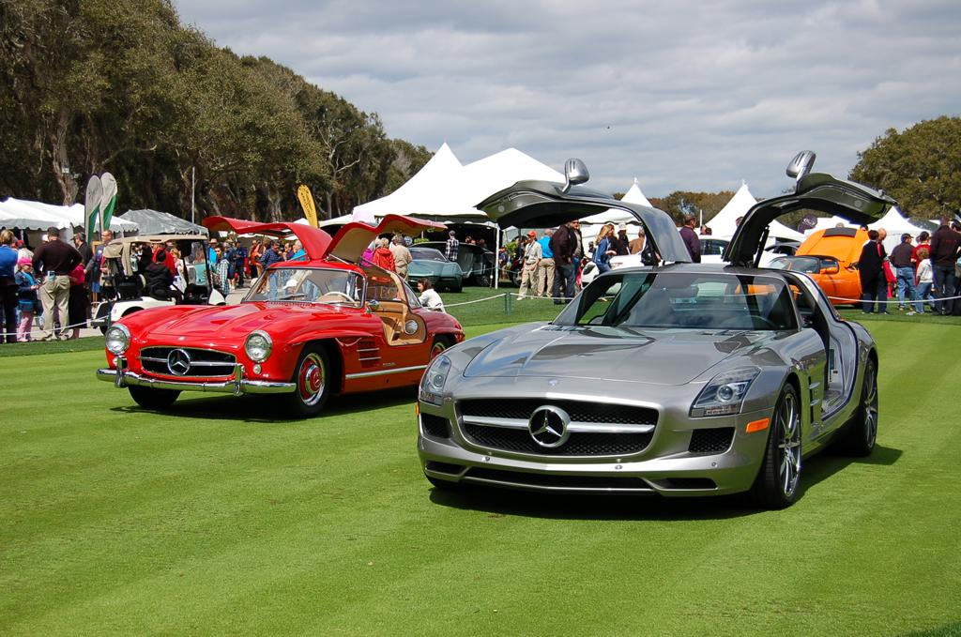
New Money Found in Older Cars
Concours d’Elegance
This “Competition of Elegance” has been held since 1929
Originally started as a competition for horse carriages
Gathering of the world’s most luxurious cars, regardless of age
Held throughout U.S. & Europe where owners compete for prizes
1954 MB 300SL next to 2013 MB SLS
2,090,000USD 250,000USD

Slide 22
Niche Factors in the Car Market

Slide 23
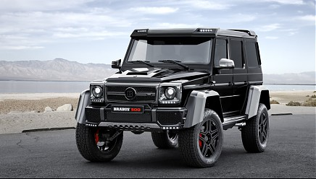
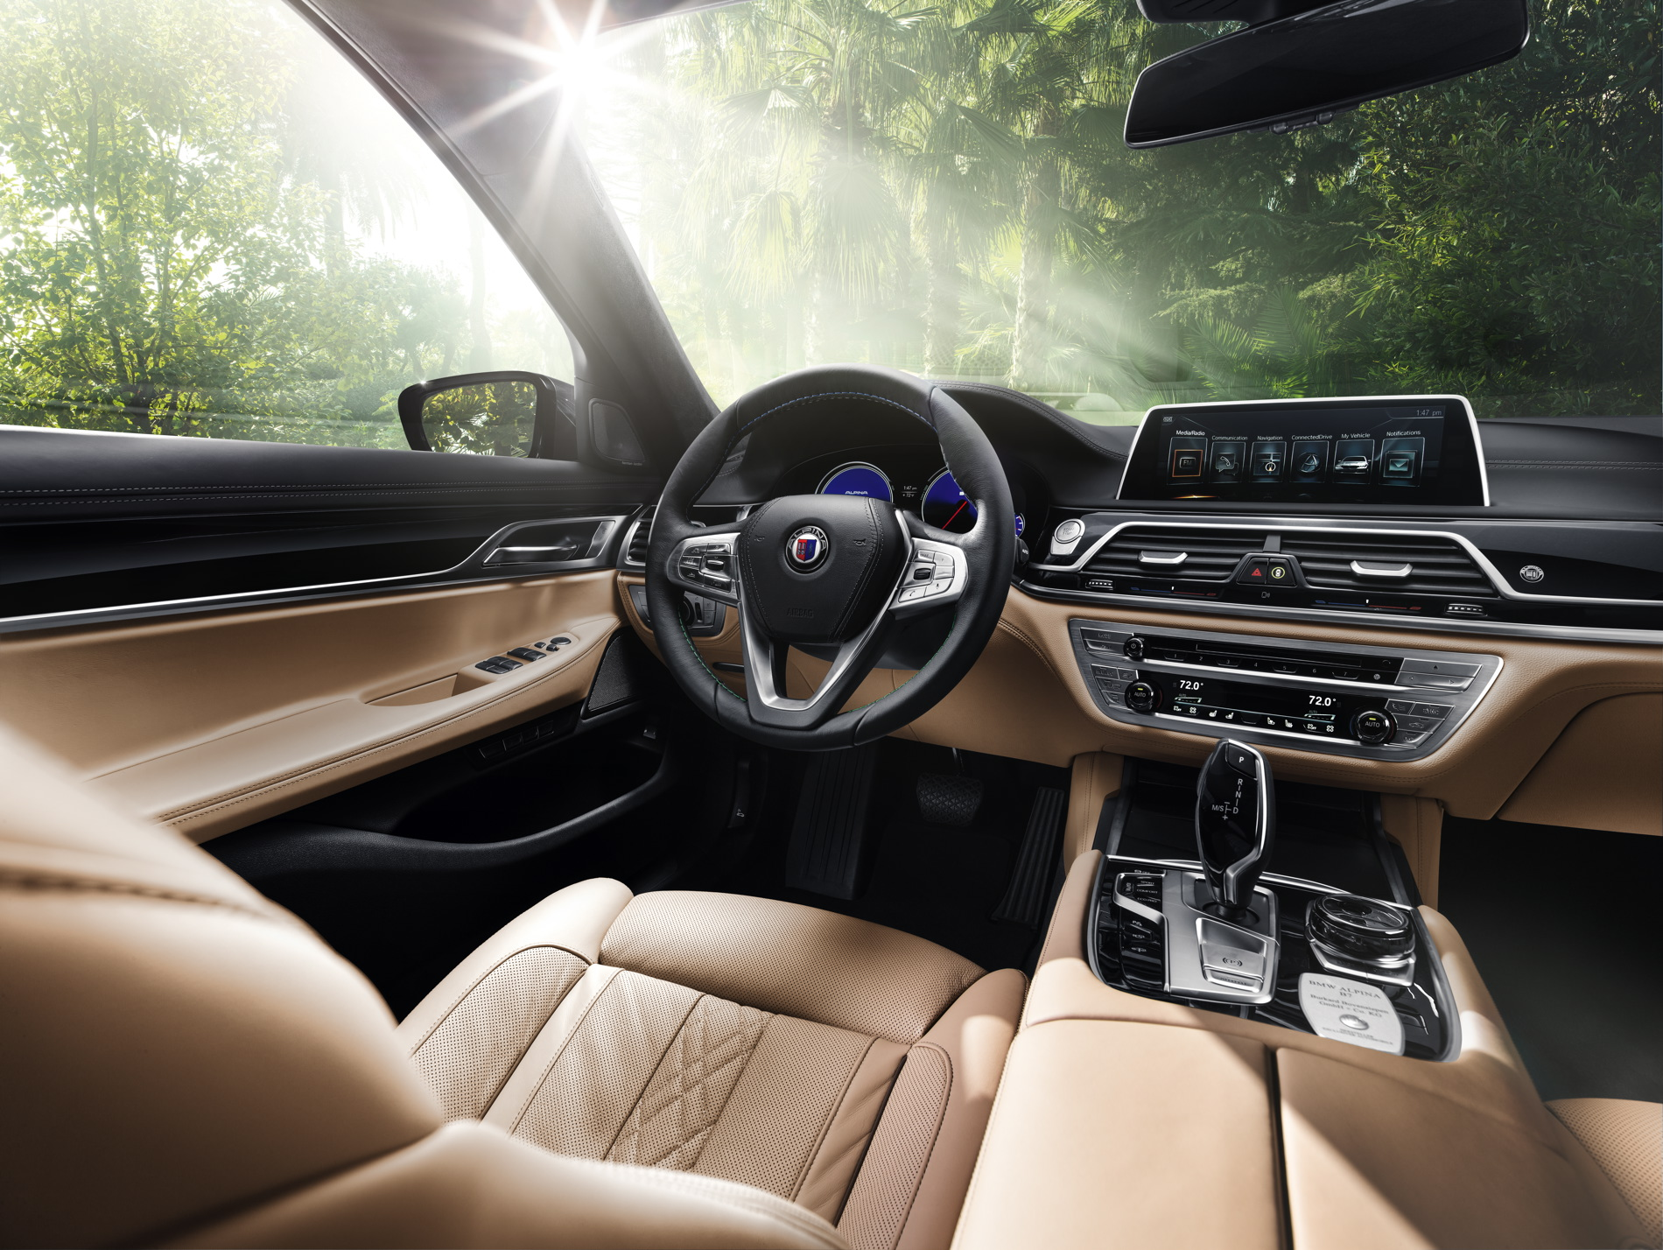
Luxury Car Tuning
Alpina
Custom Interior with Alpina marquees
20-Way power seats in Lavalina leather
Fully sanctioned by BMW, advertised on their website
Raises the price by 50,000USD
Brabus
Completely redesigned interior and exterior
Handcrafted finishes
Custom exhaust system and engine computer
Raises the price by 150,000EUR

Slide 24
Trends
Notes:
Production, relocation of factories

Slide 25
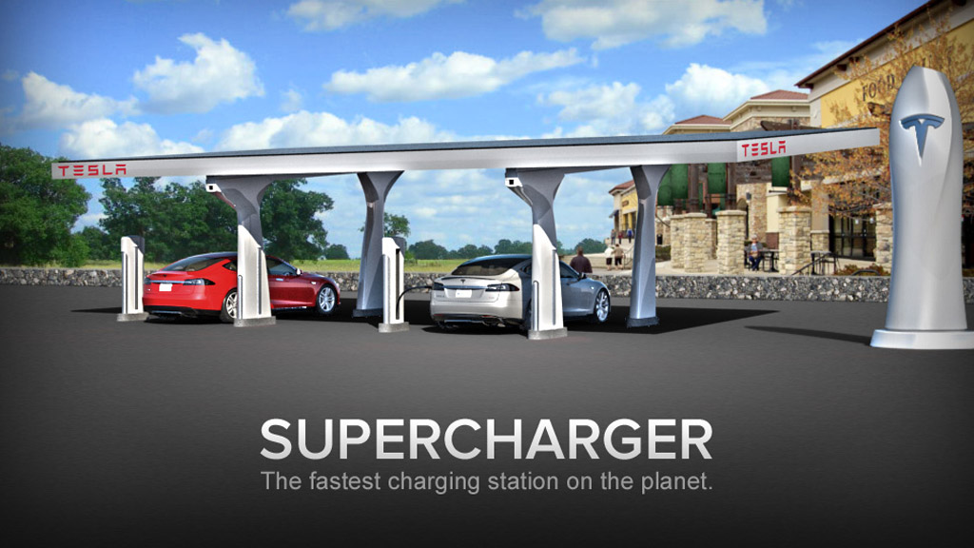
Sustainability
70% year-over-year increase in monthly sales of EV in 2016
30 EV models by end of 2016
Technology helping EV batteries become less expensive and longer lasting
Prediction EVs will be 58% of light vehicle market by 2030
Notes:
Tia
Increase in choices. By end of 2016, automakers were offering about 30 electric models to choose from, such as the Tesla Model S, Chevy Volt, and Nissan Leaf.More in future. Ford’s plans to create 13 EV models by 2020, Mercedes saying it will produce 10 by 2025, and Volkswagen, which is at work on 30 different models.
Argonne National Laboratory report predicts that EVs will make up roughly 58 percent of the light vehicle market in the United States by 2030, assuming battery-powered miles do continue to grow.
Marriott and Hilton starting to build more electric car stations in parking lot. One reason is several U.S. states offer tax incentives for installing charging stations.
In 2010, the global average was $1,000 per kWh. By last year, it had fallen to $350 per kWh.
EV expected to become mainstream, less exclusive to luxury cars due ot drop in price of EV batteries
http://www.businessinsider.com/electric-vehicle-battery-cost-decreases-2016-3
http://www.jllrealviews.com/industries/why-hotels-are-charging-up-for-electric-vehicles/

Slide 26
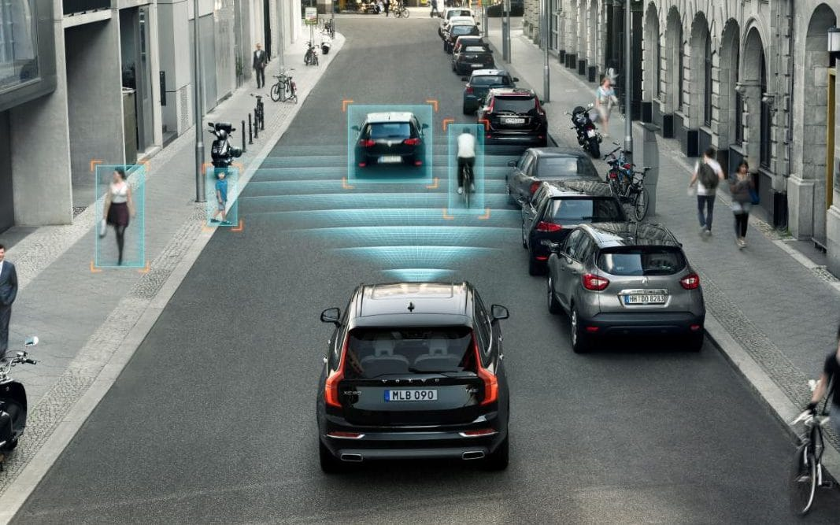
Driverless Cars
Luxury and Non-Luxury Auto manufacturers in the industry
Cars on the market with autonomous features
Raises Ethical Dilemmas
Reduction of Accidents
Notes:
Tia
The driverless technology industry is expected to be worth £900 billion globally by 2025 and is currently growing by 16 per cent a year.
Luxury and Non-Luxury Auto manufacturers in the industry: i.e. GM, Mercedes, Toyota, Tesla, BMW
GM announced last week that it planned to hire 1,100 people and invest $14 million at a new development center in San Francisco that would spearhead the company’s work on self-driving cars.
Cars on the market with self-driving features: Tesla Autopilot: include automatic steering, automatic lane change, side collision warning, and automatic parallel parking.
Ethical Dilemmas:
In the future, automated cars likely will be programmed not to speed, run lights or commit other common traffic offenses.
If an autonomous or driver-assisted car breaks the law, does the driver get a citation?
law enforcement will have to investigate whether car or human is in control of the vehicle.
But if it’s in autonomous mode, where would the citation go? What does it mean to be in control? Can you still be cited for a DUI?
Court will have to decide if it will be case law
https://www.usatoday.com/story/money/cars/2017/04/03/tesla-mishap-raises-issues-self-driving-liability/99880620/
94 percent of 2015’s 35,200 road fatalities were due to human error or choice
http://www.curbed.com/2016/10/18/13313282/driverless-cars-safety-mercedes-pedestrian
Mercedes said it would run over a child to prevent death of its occupants. 'If there is someone literally jumping in front of you, in that circumstance, there's nothing technology can do except reduce speed of impact.
http://www.dailymail.co.uk/news/article-3837453/Mercedes-Benz-says-driverless-cars-hit-child-street-save-passengers-inside.html
In a March, 2017 survey, AAA found that 78% of people polled were afraid of riding in a self-driving car, a statistic that remained unchanged from the last year. Although most people surveyed said they fear traveling in a fully self-driving car, 59% also said they would like autonomous technology in their next vehicles.
https://cleantechnica.com/2017/03/22/self-driving-cars-must-make-ethical-decisions/
30,000 deaths annually related to car accidents
How do they operate? Several systems work in conjunction
Different sensors and video cameras monitor vehicles and curbs, nearby, detect traffic lights, read road signs and keep track of other vehicles, while also looking out for pedestrians and other obstacles.
central computer analyses all of the data from the various sensors to manipulate the steering, acceleration and braking.
http://www.telegraph.co.uk/cars/features/how-do-driverless-cars-work/

Slide 27
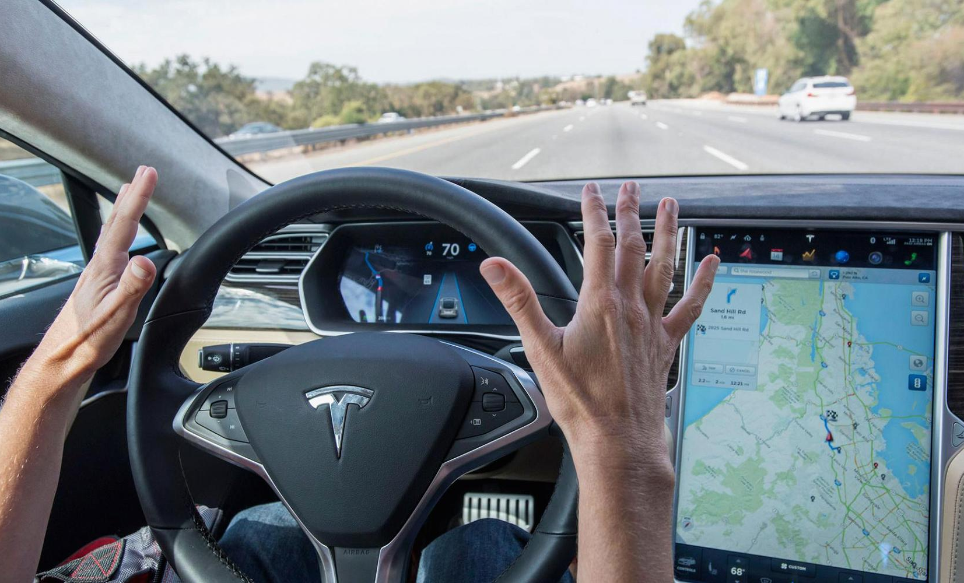
Tesla in the Autonomous Vehicle Race
Notes:
Tia
Tesla’s Autopilot: include automatic steering, automatic lane change, side collision warning, and automatic parallel parking.
Criticized that it overplayed the car's self-driving capabilities. Forced to make changes following those complaints. No longer uses any self-driving branding when marketing its cars.
Autopilot comprises multiple systems that use cameras, radar, ultrasonic sensors and data to, in Tesla’s words “automatically steer down the highway, change lanes, and adjust speed in response to traffic.” The company also claims the features “help the car avoid hazards and reduce the driver’s workload.”
Also came under fire after a series of crashes last year, one of which was fatal
http://www.consumerreports.org/tesla/tesla-autopilot-too-much-autonomy-too-soon/

Slide 28
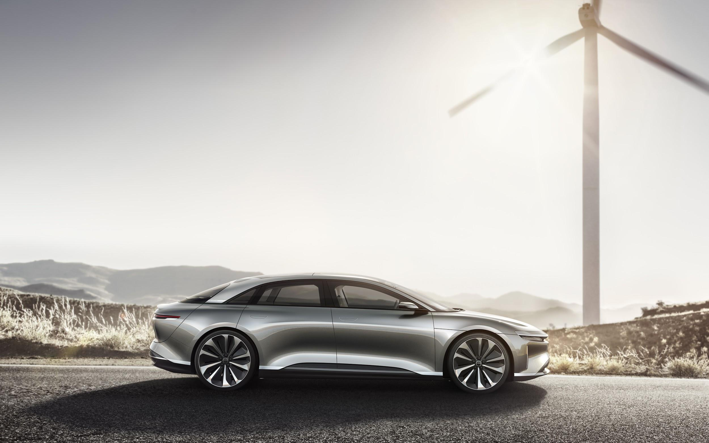
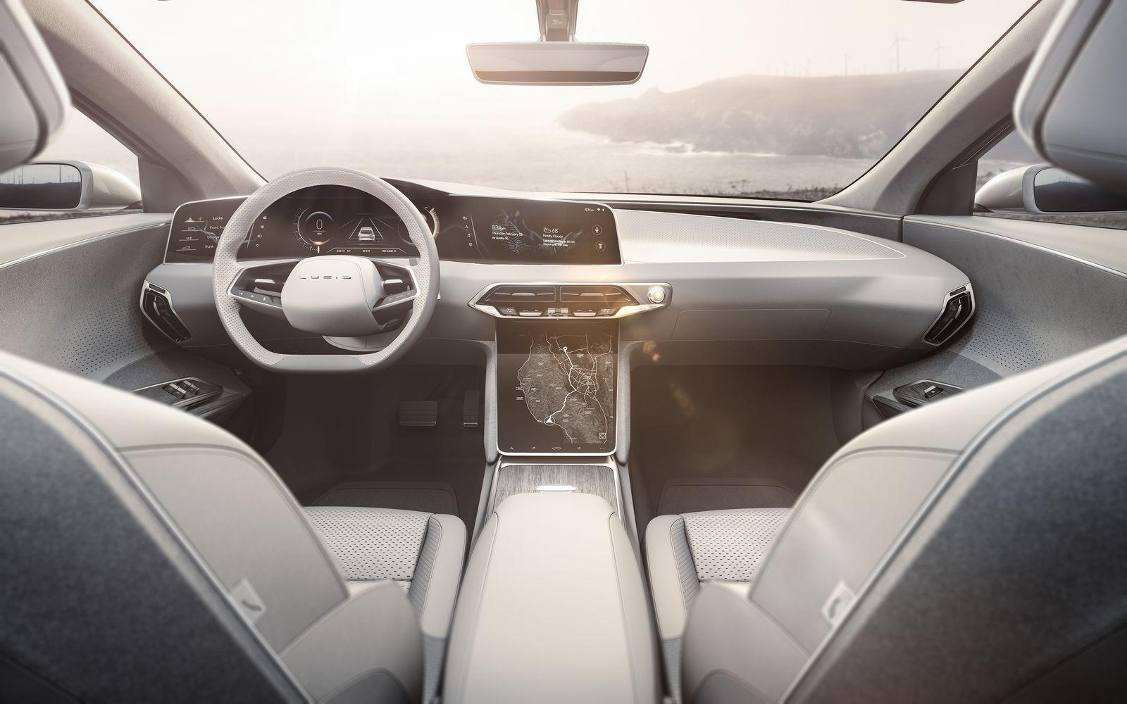
Lucid Air
315 mile range
1,000 horsepower
55 degree reclining seats controlled by touchscreen
Panoramic sunroof
Ambient color-changing light controls
Future autonomous driving features
Cost $100k+ (lower base vehicles starts at $52.5k)
Notes:
Tia
Lucid Motors
Originally a battery company when it was founded in 07 by former VP of Tesla.
http://www.businessinsider.com/lucid-air-electric-car-review-photos-2017-3/#heres-a-closer-look-at-the-car-20
Advantage over Tesla: “It's a revolutionary step forward because it's a car that is more compact on the outside and much more spacious on the inside” sculpted battery on the Air provides passengers with far more space than what any Tesla vehicle is able to provide
http://www.autonews.com/article/20170415/OEM04/304179912/what-does-lucid-air-have-over-tesla-model-s%3F
https://futurism.com/when-comes-tech-lucid-motors-seems-tech-beat/

Slide 29
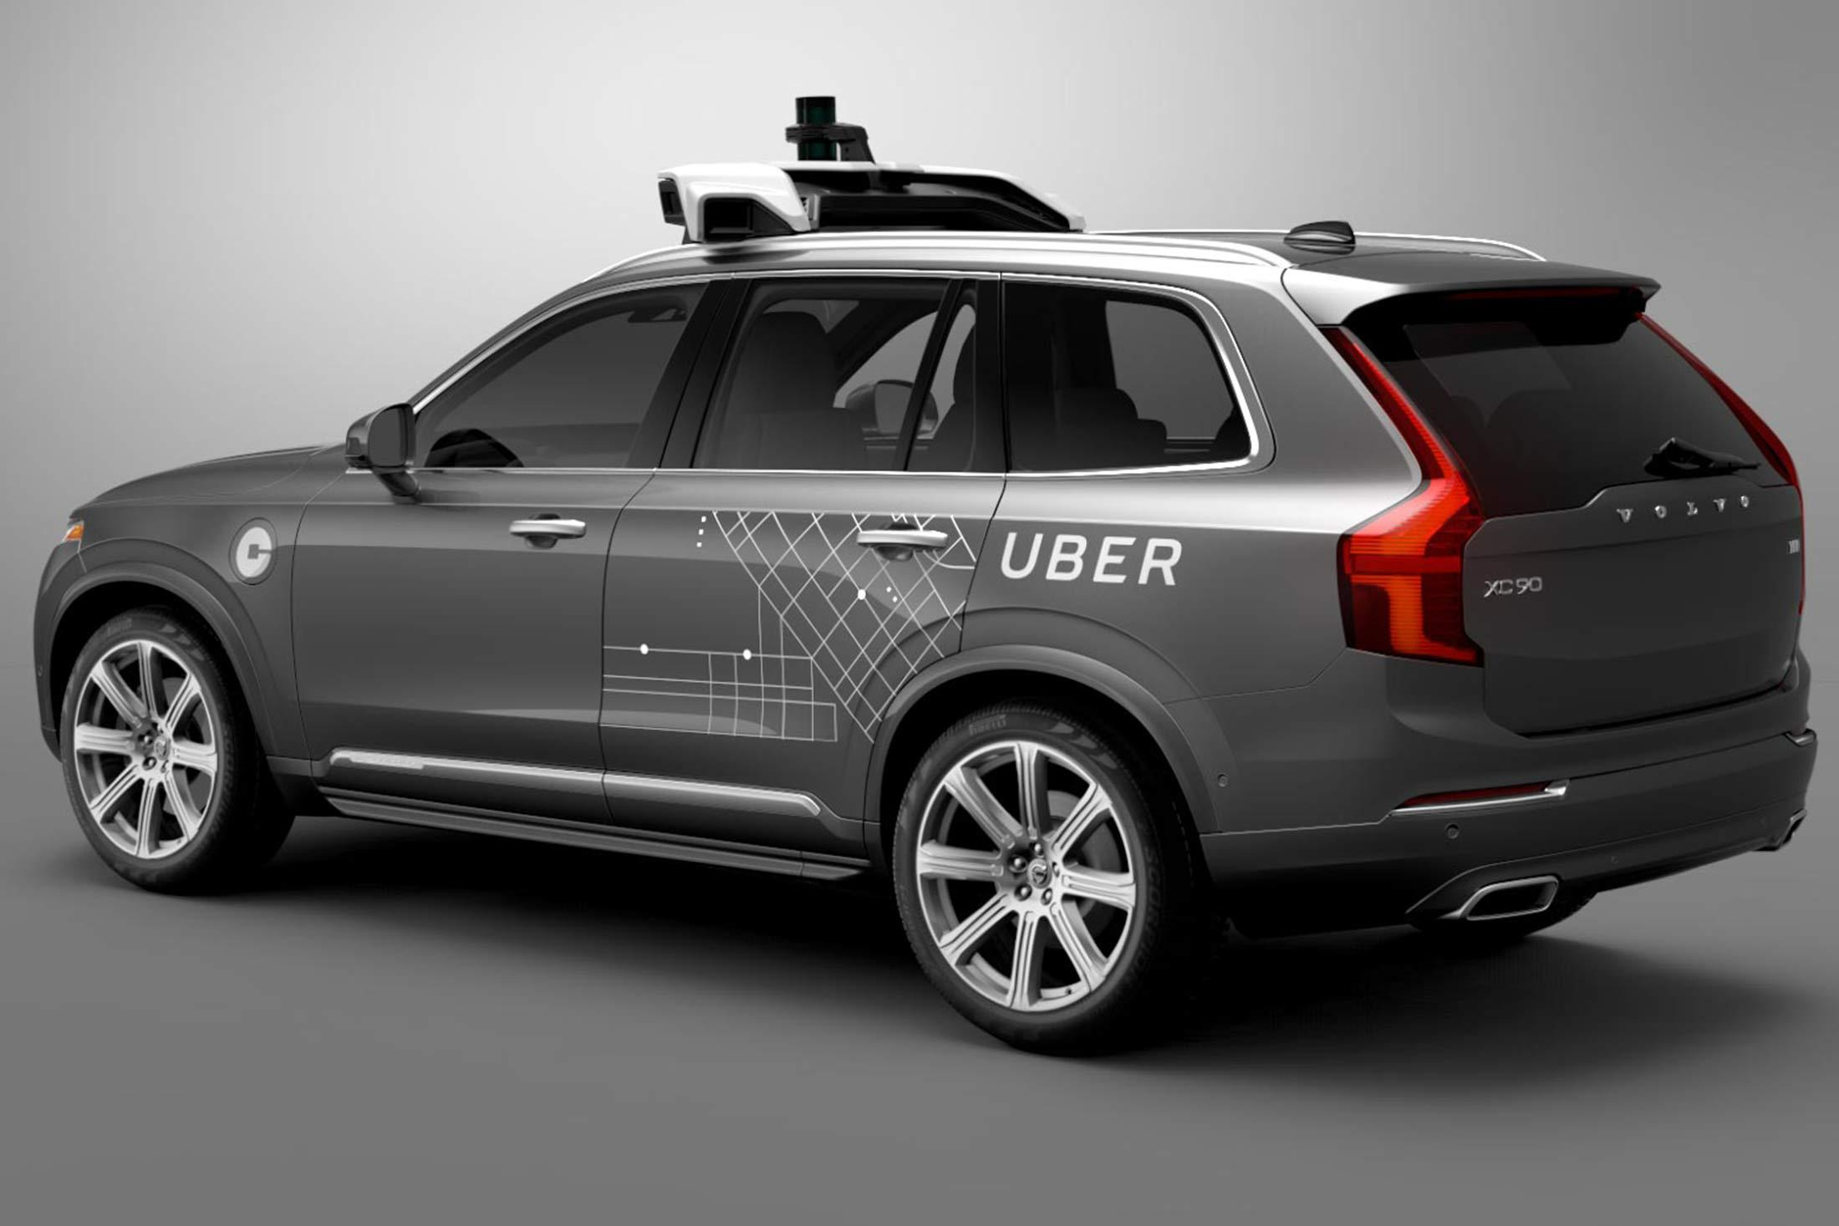
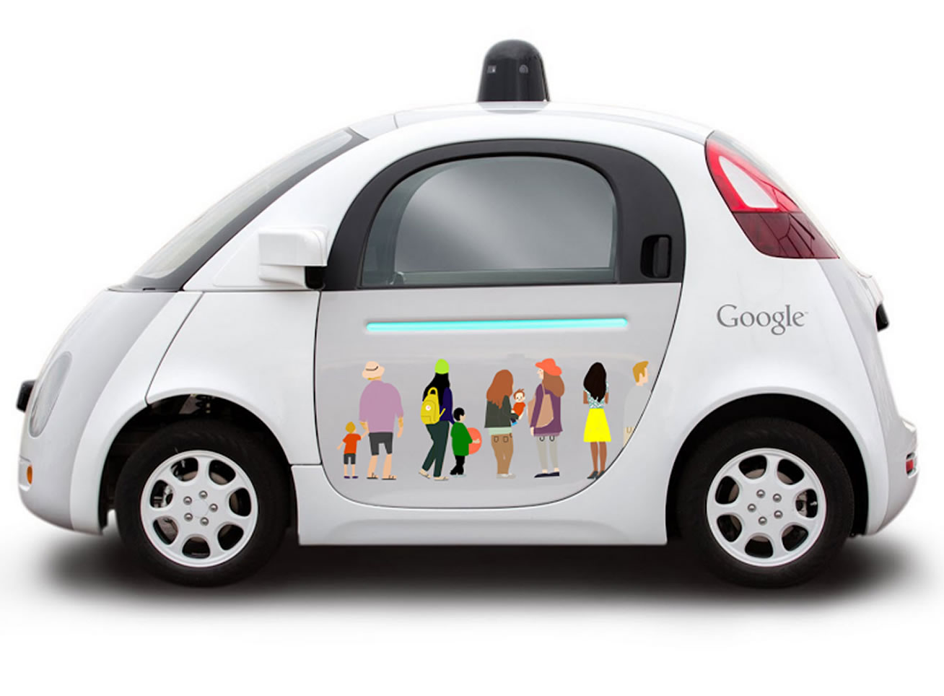
Tech Companies in the Autonomous Vehicle Race
Notes:
Tia
Apple is now the 30th tech company with such rights. They join other big-name tech firms like Google and Tesla, as well as more traditional automakers like Volkswagen, Mercedes Benz, Nissan, GM, BMW, Honda, Ford and Subaru.
Code name: “Project Titan”
Just received the approval from California DMV to test driverless vehicles on public roads.
Has never publicly discussed its efforts, but is speculated to be a part of the company’s growing strategy to diversify its product portfolio as iPhone sales decline.
http://www.marketwatch.com/story/apple-gets-to-test-driverless-cars-in-california-2017-04-14
Apple poached engineers from Lit Motors, a start-up that developed an electric self-balancing motorcycle. Apple is negotiating a possible acquisition of this company. Also chatter that it may potentially acquire or invest in McLaren, a British automotive manufacturer. http://dailycaller.com/2016/09/22/apple-in-discussion-with-luxury-car-company-because-it-feels-left-out-of-the-vehicle-industry/#ixzz4eTYNz98G
Uber launched its first driverless vehicle tests last fall in Pittsburgh and allowed everyday people to test out the service. Looking to expand its service to become more than a ride-sharing service.
In addition to car cameras and GPS systems, the car autonomously operates through a variety of advanced sensors located on top of the vehicle that uses a laser that gathers 1.4 million different map points in one second.
Company reports show that the self-driving cars can barely drive a mile before they "disengage” and a safety driver has to take control of the vehicle.
http://dailycaller.com/2016/09/14/uber-launching-driverless-cars-in-pittsburgh-starting-today/
http://www.businessinsider.com/uber-driverless-cars-need-human-help-2017-3/#the-internal-documents-show-the-self-driving-cars-havent-come-too-far-along-since-i-got-behind-the-wheel-last-september-11
Currently a lawsuit between Uber and Google. Google claims Anthony Levandowski, once on Google’s self-driving car team, stole 14,000 files pertaining to Google’s proprietary self-driving technology when he left Google to form his own self-driving technology start-up, Otto, which was later sold to Uber for half a billion dollars. Uber, which stands accused of facilitating intellectual property theft, has requested arbitration to prevent the case from going to trial.
http://www.bbc.com/news/technology-38839071
http://www.vanityfair.com/news/2017/04/no-evidence-uber-fires-back-at-google-over-driverless-car-lawsuit

Slide 30
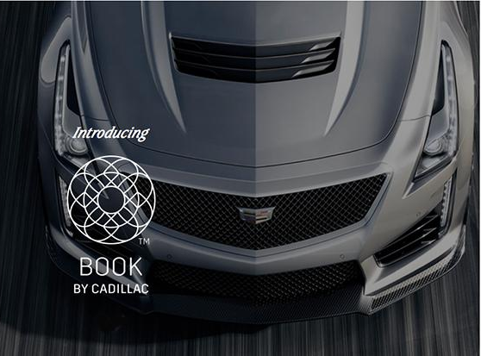
Book by Cadillac Subscription Service
Rent a Cadillac for $1,500/month using an app
Select model and concierge delivers to you
Does not require insurance
Can exchange car model up to 18 times a year
No mileage restrictions
Notes:
Tia
Currently beta test on NYC
Millennial trend accessibility vs ownership
https://venturebeat.com/2017/01/29/rent-a-luxury-car-for-1500-a-month-theres-an-app-for-that/
https://www.bookbycadillac.com

Slide 31
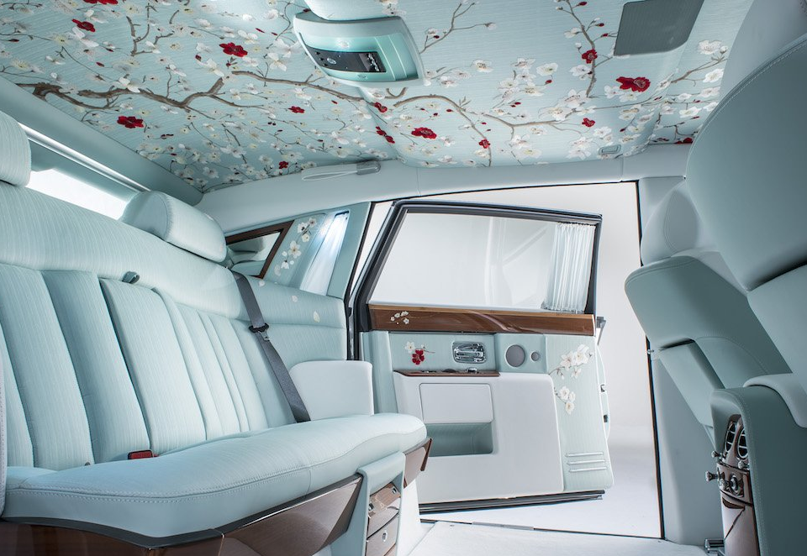
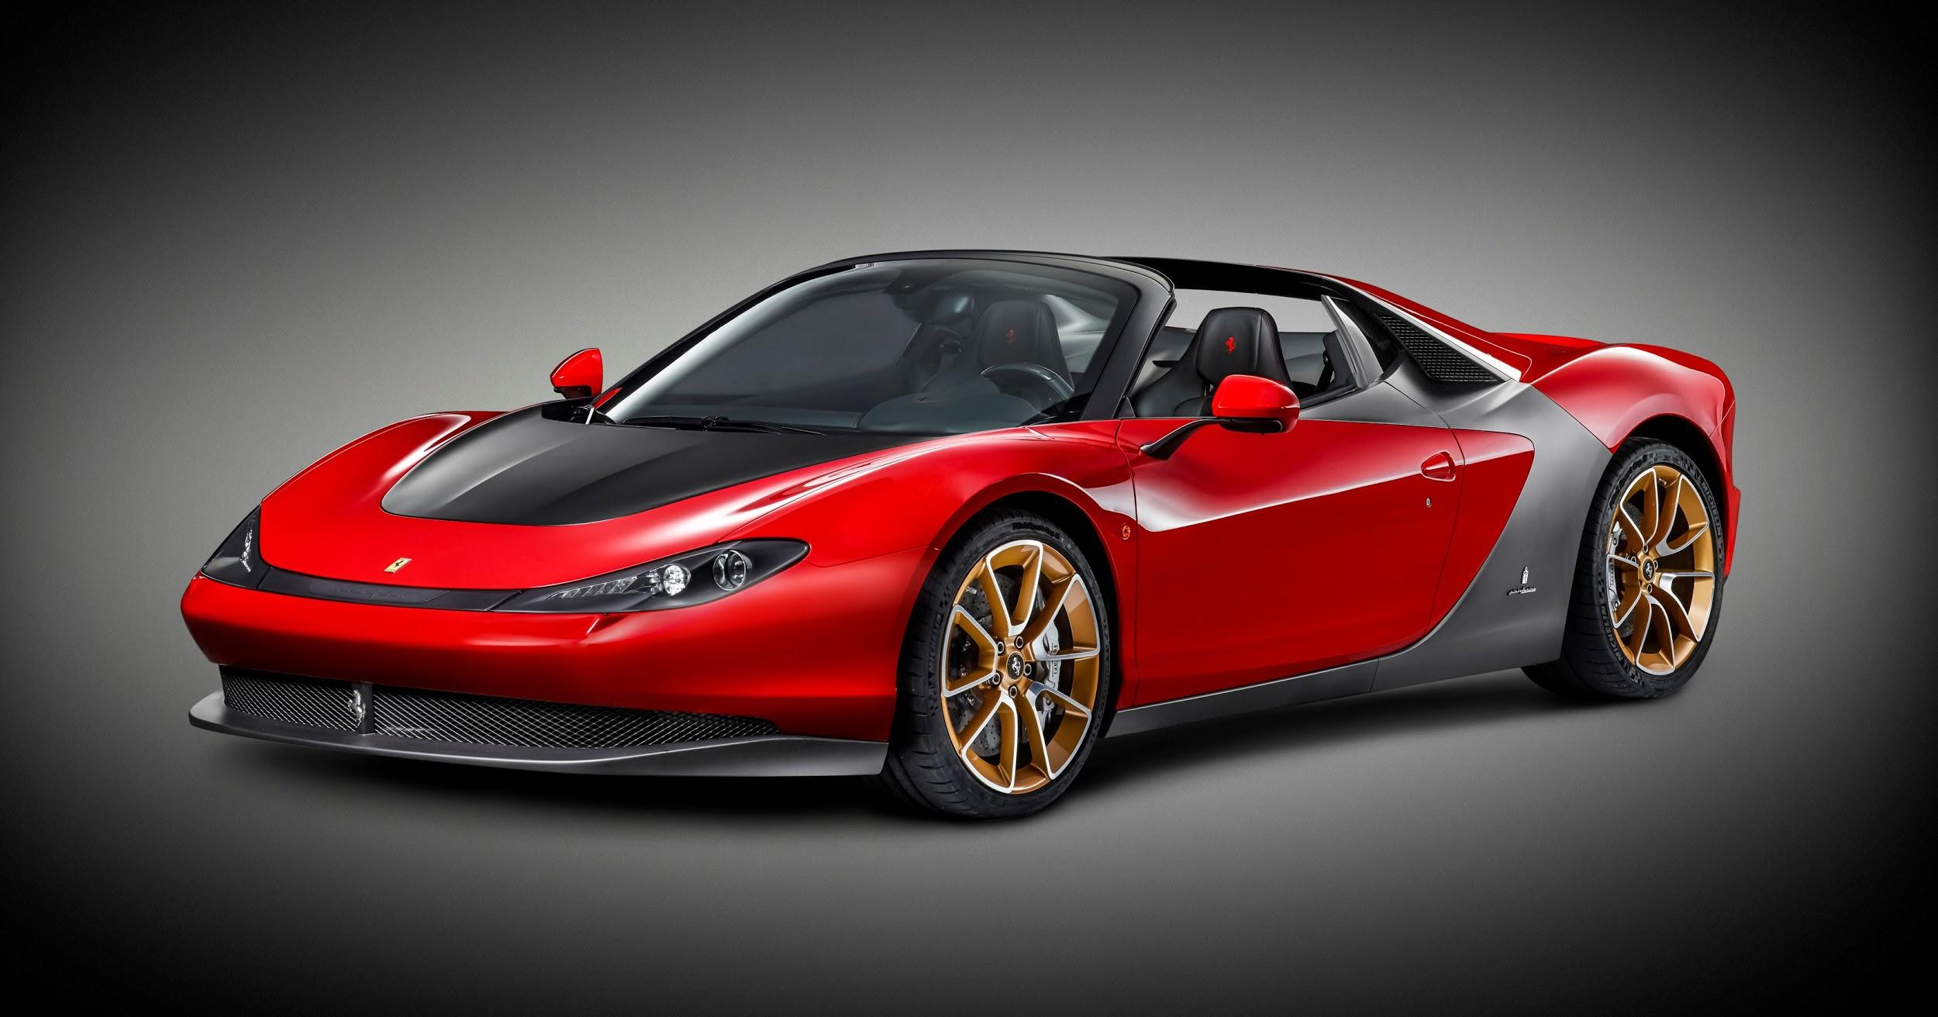
Customization
Dilution of exclusivity due to growth of market => push for unique designs in battle for exclusivity
Being wealthy isn’t enough, want to be wealthy and unique
“It is like creating art. Anybody that comes in and orders a $400,000 car wants the experience to be totally special.”
“Q by Aston Martin” and McLaren “Special Operations” division
Exception: hyper-exclusive and limited “works of art”
Notes:
Tia
Rolls-Royce report record number of buyers who are choosing to customize vehicles, at
http://www.businessinsider.com/the-7-most-luxurious-car-interiors-photos-2016-2/#7-land-rover-has-taken-its-flagship-design-and-added-luxurious-perks-to-create-the-2016-svautobiography-1

Slide 32

Luxury SUVs
Reasons for shift in focus:
Fastest growing luxury segment: compact luxury SUVs grew 19.4% in 2014
Account for 21.4% of luxury segment
Government-mandated fuel economy rules encourage growth in luxury SUVs
Niche segment to attract new buyers
Market shift driven by women
57% who bought luxury vehicle in 2016 bought SUV
Over 40% of luxury vehicles sold to women
Notes:
Serena
In 2016, luxury SUVs will outsell luxury passenger cars in US for first time
55% of market share (2016) → 60% 2017

Slide 33

Luxury SUV: strong competitive advantage
Notes:
Serena
Volvo brand turnaround from safe car to high-end luxury car
Smaller luxury auto makers used new SUVs to become relevant players
Jaguar F-Pace, Volvo XC90
Bringing growth to brands that historically have been considered niche players (Jaguar and Volvo)
Also saving many companies’ poor sales performance
Through July 2016, Bentley was on track for its worst U.S. sales year since 2010
SUVs to the rescue! After averaging 113 monthly sales between January and July, Bentley reported 399 sales in August 2016
The Bentayga generated 56% of all Bentley sales
If the Bentayga was the only Bentley on sale in America in August, its 223 sales would still have produced Bentley’s best month of sales this year, and by a long shot.
http://www.thetruthaboutcars.com/2016/09/ungainly-bentayga-cayennes-bentley-first-month-market/

Slide 34




Luxury SUV: strong competitive advantage
Notes:
Serena
2018 Mercedes Maybach G650 Landaulet (99 units): $400,000
2017 Bentley Bentayga: $240,000
2018 Rolls Royce Cullinan SUV: $330,000
2017 Maserati Levante SUV: $73,000

Slide 35
Relocation of Factories
Manufacturing and production locations central to many luxury brands’ core identities
Ferrari: Maranello factory in Italy (Made in Italy tag)
Lamborghini: Bolognese, Italy
Maserati: Italy
Rolls Royce: Goodwood, England
Aston Martin: Gayton, Warwickshire, England
Due to expansion into premium production lines, many have corroded identity with global manufacturing sites
BMW: 14 countries
Mercedes: 11 countries
Audi: based in Germany but global manufacturer
Jaguar and Range Rover: mainly UK, but also Brazil, China, India
Notes:
Serena

Slide 36
Relocate to Cut Costs
Volkswagen utilizing network and scale to provide economies of scale to brands
Costs saved but brand heritage compromised
“Made in ______” → “Assembled in ______”
Doubts regarding quality of products produced in low-cost locations
Production for Porsche Cayenne SUV, Bentley Bentayga SUV and Lamborghini SUV moved to Bratislava, Slovakia
Cut significant costs
Increase production to meet demands
Notes:
Serena

Slide 37




Online Marketing

Slide 38


From Selling to Inspiring
2013 Bentley Flying Spur
Lamborghini Aventador S

Slide 39
Anti-Laws of Marketing Implications
The luxury car industry defies some of the ALMs:
Forget about positioning, luxury is not comparative
Do not respond to rising demand
Do not relocate factories
Do not look for cost reduction
Do not look after group synergies
Do not pander to your customers’ wishes
Dominate the client
Do not sell

Slide 40
Thank You
Questions?

Slide 41
Discussion Questions
Do you think luxury subscription services i.e. Book by Cadillac will eventually trump luxury vehicle ownership in the future?
With cars moving towards a driverless future, what do you see the next step car manufacturers will take to provide a “luxury” experience
Do you think moving manufacturing outside of a luxury brand’s home country dilutes its brand value (i.e. if Ferrari moved production outside of Italy)?
Notes:
Tia?

